Slide 1

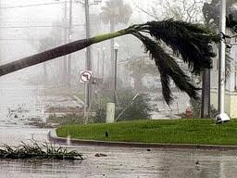
Charlotte County Tax Collector
Disaster Preparedness Plan
Presented by: Matthew Mattson
Systems Administrator
Charlotte County Tax Collector

Slide 2
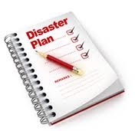
What We Will Cover
Importance of Having a Disaster Plan
Quick Overview of Charlotte County Tax
Collector’s Disaster Preparedness Plan
Disaster Scenario Demo

Slide 3
Disaster Preparedness Facts
89% Businesses Important to be Prepared
1/3 of Businesses DO NOT Have a Plan
60% Americans Unprepared for Disasters of Any Kind
40% Businesses Never Re-open After Disaster
* Information from American Red Cross

Slide 4

Local Government Benefits
Help Reduce Recovery Costs
Promotes Collaboration Among Departments
Reduces Downtime
Strengthens Local Government

Slide 5

Emerging Trends Impacting Disaster Preparedness
Cloud Computing
  Remotely Hosted
  Can Be Run Anywhere
  Internet Connection Required
  Lower Equipment Costs
  Lower Maintenance Costs

Slide 6
Importance of Disaster Preparedness Plan
Why have a Disaster Preparedness Plan?
Always Prepared
Minimize Effects of Disasters
Allow For Quick Recovery
Keep Data Safe
Keep Public Services Open
Raise Public Moral
Lessen Confusion

Slide 7

Before Current Disaster Preparedness Plan?
What would we do in a Disaster?
Does Not Exist
Basic Fire & Evacuation Plan

Slide 8
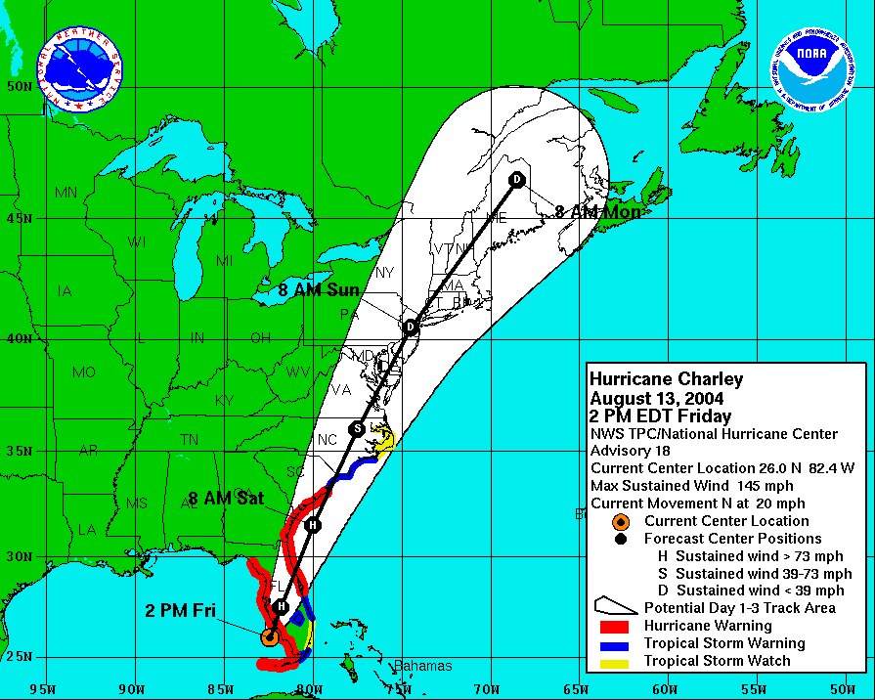
Realization of a Needed Plan

Slide 9
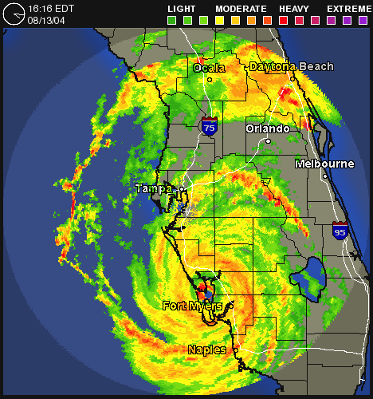
August 13, 2004 – Hurricane Charley

Slide 10
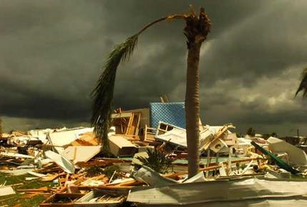
We Need a Plan!
Wake Up Call Realization
Friday, August 13, 2004: Direct Hit from Hurricane Charley
No Plan = Confusion
Communication Breakdown
Luckily No Major Office Damage
Could Have Been Much Worse
Need to be Ready For Future Disasters

Slide 11
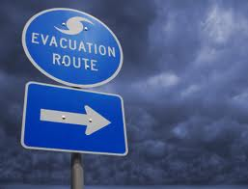
Disaster Preparedness Plan Alternatives
Have No Plan: Wing It
Have a Plan
  Fire Evacuation Procedures
  Severe Storm Procedures
  Total Disaster Preparedness Plan

Slide 12
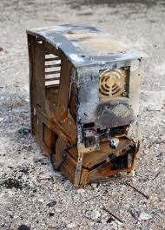
What is in the Disaster Preparedness Plan?
Plan For the Following
  Fire
  Flood
  Hurricane
  Tornado/Severe Storm
  Terrorism/Destruction of Property
Types of Disasters
  Local Server Room : Only Affects Data Warehouse
  Building : Whole Building Damaged or Destroyed
  Regional : More than 1 Building Damaged or Destroyed

Slide 13

Budget Analysis
Minimal Budget Impact
  Software
Tivoli Storage Manager
  Hardware
    StorServer Backup Appliance
    Backup Power Generators
    Battery Backup
    Buildings Already Retrofitted

Slide 14

Staff Buy-In
How to Sell The Plan
Effective Communication
  Staff Meetings
Cooperation
  Importance of Employees
Employee Participation
  Feedback
Refresher Meeting
  Scheduled Once a Year

Slide 15

Risk Management
What are the risks involved?
Employees Not Participating
Key Staff Members Absent
Plan Failure
  Loss of Data
  Confidential Record
  Falling Below Public Expectations

Slide 16

Risk Management Solutions
What are the risks involved?
Employees Not Participating
Solution: Staff Meetings/Sell the Plan
Key Staff Members Absent
Solution: Assign Backup Key Staff
Plan Failure
  Loss of Data
  Confidential Record
  Falling Below Public Expectations
Solution: Test Plan Once a Year
Maintain & Update Plan as Needed
Refresh Staff During Yearly Meeting

Slide 17

11 Steps To Design Disaster Plan
Organize the Project
Define Potential Disasters
Prevention Analysis
Gather Critical Information
Define Disaster Impact Statements
Vendor Support
Planning Sessions
Design Plan
Share Plan With Staff
Test Plan
Maintain Plan

Slide 18
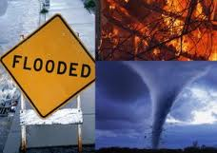
Prevention Analysis
Fire
Flood
Hurricane
Tornado/Severe Storm
Terrorism/Destruction of Property

Slide 19
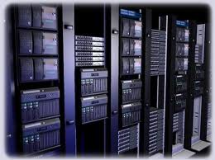
Define Critical Services and Functions
Define List of All Systems
Set Priority of Services and Functions
What Systems Are Most Important?
Order of Recovery?

Slide 20
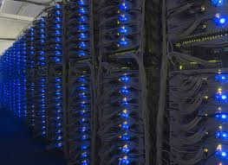
List Of Systems
Grant Street TaxSys
Exchange (Email)
RTL High Speed Processor
Metafile (Imaging & Archiving)
Hunting/Fishing
Web Server (Website)
FDLIS
FRVIS
MUNIS (Financial)
Internet Connection

Slide 21
Define Critical Services and Functions
System / Function | Order of Priority
Internet | 1
MUNIS Financial System | 2
Grant Street TaxSys (Collection Software) | 3
FDLIS (Driver License) | 4
FRVIS (Auto Tags) | 5
Web Server (Website) | 6
Exchange (Email) | 7
Hunting/Fishing License | 8
Metafile (Imaging & Archving) | 9
RTL High Speed Processor | 10

Slide 22

Assign Key Recovery Team
Assign Key Staff Members to Disaster Recovery Team
  Responsible For Recovery Duties
Priorities and Responsibilities
  Assign to certain Offices?
  Workstation Recovery?
  Servers?
Train Staff
  Meetings
Assign backup Key Staff in case of absences

Slide 23
Define Disaster Types
Localized Server Room Disaster
Only Data Warehouse Affected
Servers / Network Equipment Damaged or Destroyed
Customers and employees would expect the same level of service as before the time of the disaster.
Employees would have access to their files and computer hardware such as pcs and local printers.
Some network files and folders might be temporarily unavailable while the network is re-established.

Slide 24
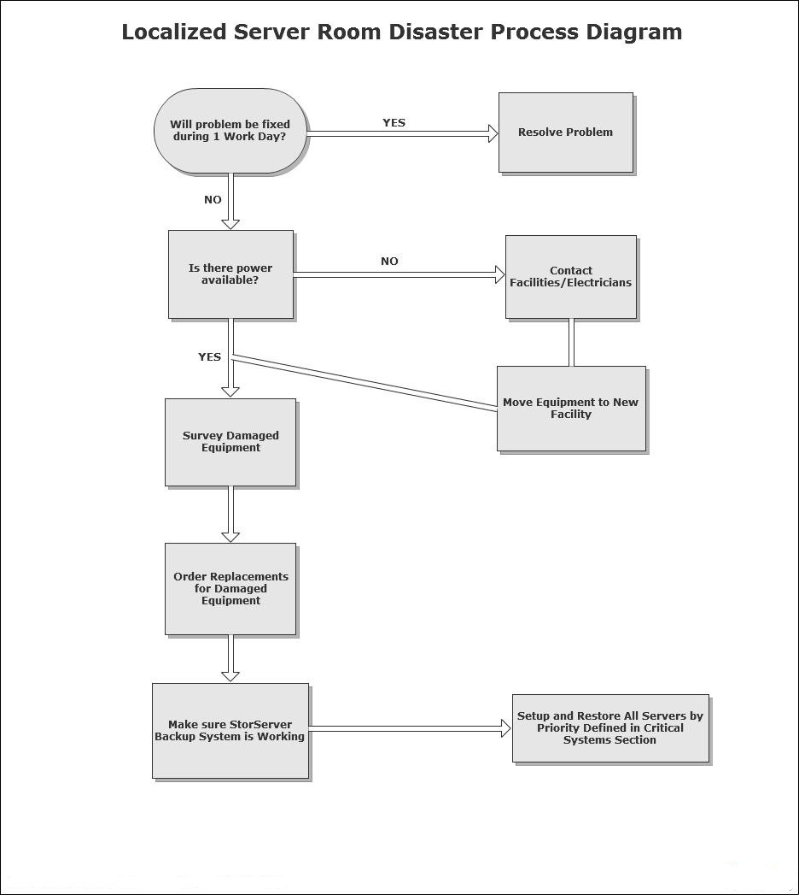
Local Server Room Disaster

Slide 25
Define Disaster Types
Building Disaster
one of our buildings has been damaged or destroyed
Employees of the damaged building have no place to work.
Computer hardware such as pc’s and printers is non-functional.
Customers will expect to have the same level of service as before the time of the disaster.

Slide 26
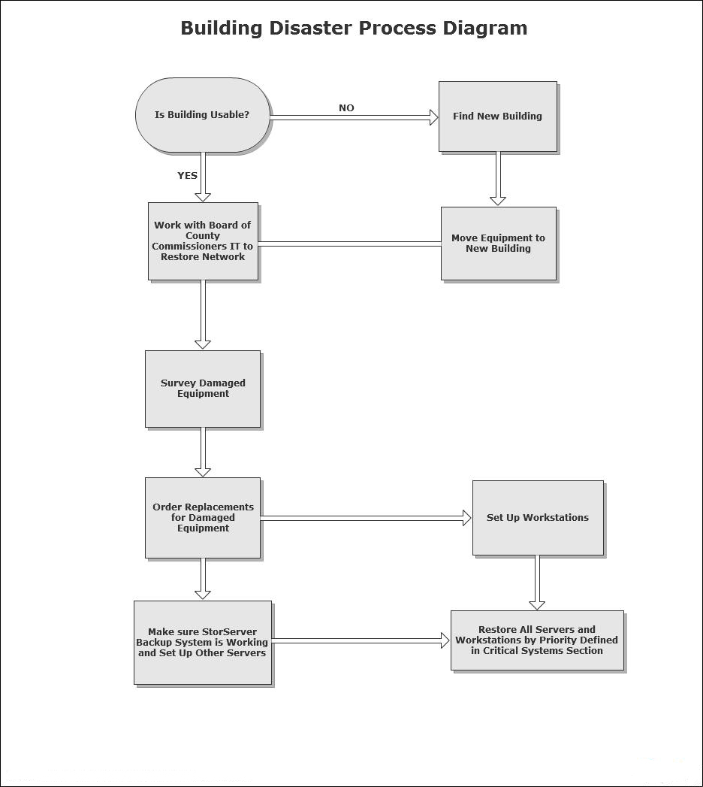
Building Disaster

Slide 27
Define Disaster Types
Regional Disaster
All of our buildings have been damaged or destroyed
All IT equipment such as pc’s, servers, and printers is
either damaged or destroyed.
Employees do not have a permanent office to work in.
Some employees will be displaced due to damage of their personal belongings.

Slide 28
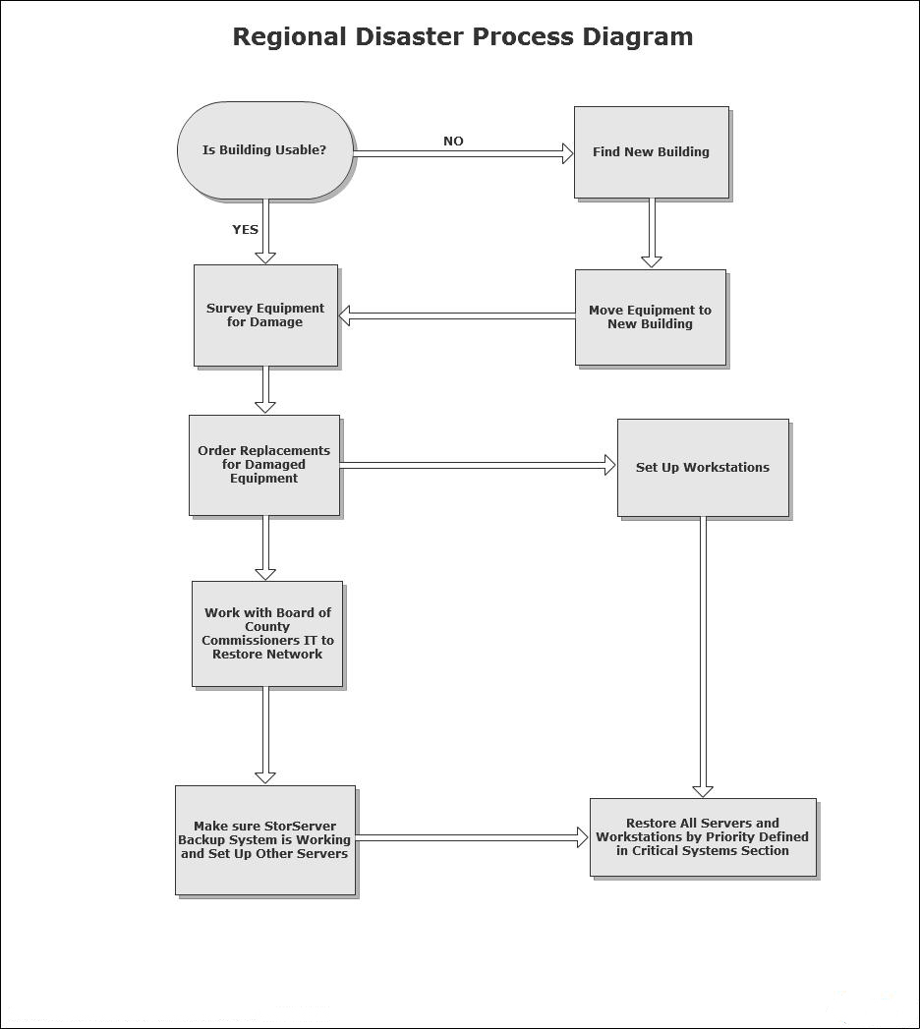
Regional Disaster

Slide 29

Information Gathering
Building Locations (Safety Equipment, Elevation, etc)
Emergency Employee Telephone List
Home Phone Number
Cell Phone Number
Hardware Inventory
Computer Name, Location, Serial #, etc
Network Diagrams
Hardware / Software Vendor List
Company Name
Contact Person
Phone Number
Support/License #

Slide 30
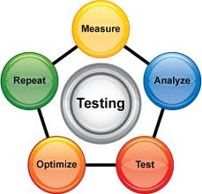
Test & Maintain the Plan
Does the Plan Still Work?
Test the Plan Once a Year
Update the Plan as Needed
Fix Any Flaws That Show Up
Key Staff Member Input

Slide 31
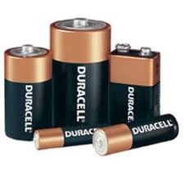

Supply Checklist
Batteries
Flash Lights
Box of Tools (each office)
Plastic Tarp or Garbage Bags
Office Keys (Not just Electronic Badge)
Gasoline
Water
Backup Tapes (Sent to Vital Records)
Extension Cords
Regular Telephone (Not Electric or Portable)
Cell Phone (charged)
Text Messaging Might Work Better Than Voice
First-Aid Kit
Safe

Slide 32
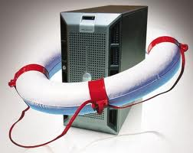
Having a Plan is Very Important
Disaster Preparedness Plan Very Important
Centralized Location of Important Documents
Guide For Recovery
Help Minimize Confusion After Disaster
Communication is KEY for Success
Test the Plan
Maintain the Plan

Slide 33
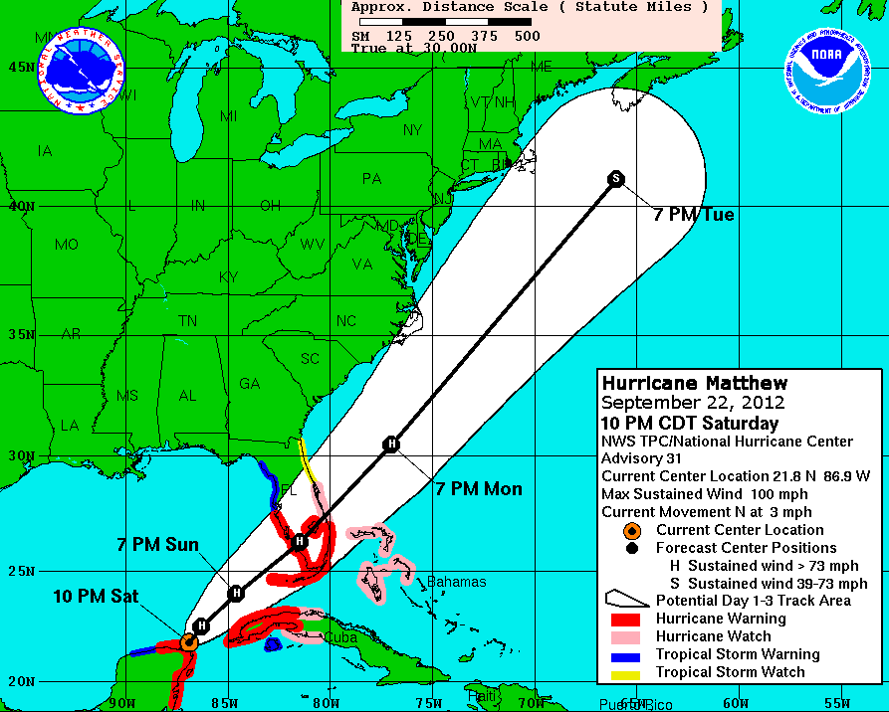
Quick Disaster Scenario Demo
Hurricane Matthew
Area under Hurricane Warning
Expected to hit in about 36 Hours

Slide 34
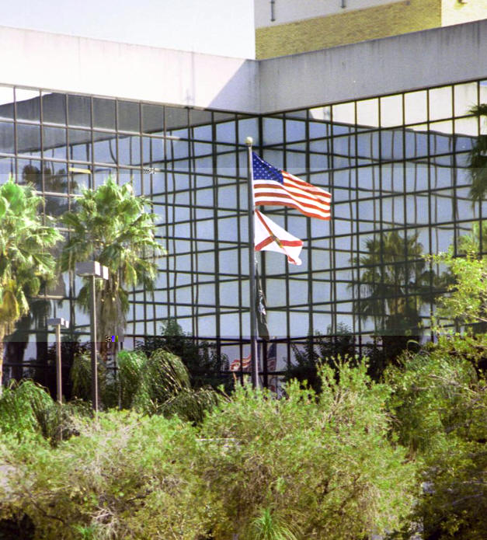
Charlotte County Tax Collector Facts
66 Employees
3 Office Locations
  Port Charlotte
  Englewood
  Punta Gorda
Tax Collector: Honorable Vickie L. Potts

Slide 35
Quick Disaster Scenario Demo
Attend Emergency Management Official Briefing
Expect sustained winds of around 115mph
Storm Surge of at least 8 to 12 Feet
Major Power Outages
Brief Tornadoes
Rainfall at least 10+ inches
Possible Flooding of Zone A (Punta Gorda Office is Zone A)

Slide 36

Quick Disaster Scenario Demo
Preparation for Category 3 Hurricane
Meeting with key Staff
Communicate to Staff via intranet, email, messaging, phones
IT Staff sent to Punta Gorda & Englewood offices for preparation
Hardware raised to avoid Flooding Damage to Equipment
Secure Equipment
Ensure backups are complete & Tapes Secured
Buildings Secured by Facilities Department (Shutters, etc)
Final Meeting with IT Staff and Managers

Slide 37
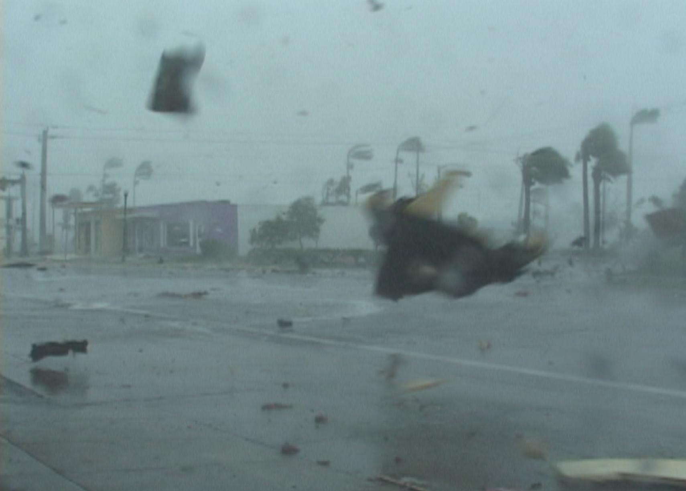
Hurricane Matthew 2012
Scene from downtown Punta Gorda near our office

Slide 38
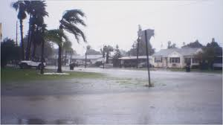
Quick Disaster Scenario Demo
Post Hurricane Recovery
IT Staff Evaluates Offices & Hardware Infrastructure
Supervisors Contact Staff Members
Emergency Management Meetings

Slide 39
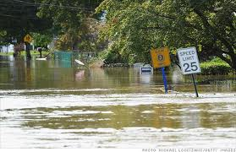
Quick Disaster Scenario Demo
IT Evaluation Summary
Murdock (main office)
  Power On (Running on Generator Power)
  No Structural Damage
  No Flood/Water Damage
Englewood Office
  Has Power
  No Structural Damage
  No Flood/Water Damage
Punta Gorda Office
  Power Out (No Generator)
  Slight Roof Damage
  Flooding Damage (1 foot of water in building from storm surge)

Slide 40
Quick Disaster Scenario Demo
Recovery Plan of Action
IT Staff makes sure all servers up and fully operational
Staff Notified to Report to Murdock & Englewood Offices Only (Closest)
IT Staff follow the correct Recovery Process (from Diagram)
  Local Server Room, Building, Regional Disasters
    Only 1 Building Affected = Building Recovery Process
No hardware damaged due to preparation ahead of storm
  All hardware was lifted and secured to protect from water damage

Slide 41
Building Disaster

Slide 42
Quick Disaster Scenario Demo
Recovery Plan of Action
Offered work space at Judicial Center
  Judicial Center has power (Generators Running)
  Work with BCC to setup temporary network
  Setup temporary workstations and test
  Punta Gorda Staff sent to work at Judicial Center
Punta Gorda office repaired by Contractor/Facilities
  Work with BCC to repair/restore network connections
  Move equipment back to Punta Gorda office
  Setup workstations, DMV Server, etc
  Test
  Staff reports back to fully operational Punta Gorda office

Slide 43

Quick Disaster Scenario Demo
Maintenance to Plan
Update plan as necessary (Annual basis)
  Staff Changes
  Updated Emergency Phone Lists
  Updated Hardware Inventory
  Improvements to Procedure?
Finalized Plan?
  Not set in stone
  Work in Progress
  Needs Constant Updating to remain relevant

Slide 44
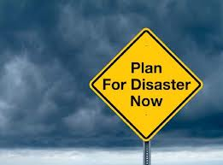
Disaster Plan In Summary
Helps With Preparation Before/After Disaster
Very Important Document
Auditors Like to See Your Plan
Eases Confusion Before/After Disaster
Requires Cooperation Among Staff & Other Departments
Needs Constant Updating

Slide 45


What are the 2 Constants in Life?
1. Death
2. Taxes
Therefore, your office needs the Emergency Preparedness Plan to work successfully so you can still collect those taxes!

Slide 46

Questions?

